Slide 1
Experimental Study on the Effects of Cone Angle and Gas Inlet Diameter on the Minimum Spouting Velocity in 2D Conical Spouted Beds
Ronald Breault, Steven Rowan, Jerome Raque III

Slide 2
Outline
Introduction
Background
Experimental Setup
Preliminary Results
Ongoing Work and Future Plans

Slide 3
Introduction
Overall Objective:
To develop a modular, “stackable”, network of high temperature reactor vessels for the processing of cohesive Geldart C materials.
Conceptual diagram of a modular chemical reactor for cohesive fines.
Geldart particle classifications as a function of mean particle diameter and particle-to-gas density difference.
Conceptual diagram of a spouted bed with poly-dispersed particle sizes.

Slide 4
Background
The nature of the “problem”:
Non-heterogeneous gas-solid chemical reactions
Typically diffusion controlled
The more contact area between gas and solid, the better.
Smaller solid particles have a larger surface area to ratio volume.
Fluidization of fine particles
Smaller particles are more greatly affected by inter-particle cohesive forces.
Van der Waals Force
Electrostatic Forces
Cohesive particles are difficult to fluidize.
Conceptual diagram of channel flow in a bed of Geldart C particles. (Shabanian, et al. 2012)
Trade off between maximizing reaction kinetics and ease of fluidization!

Slide 5
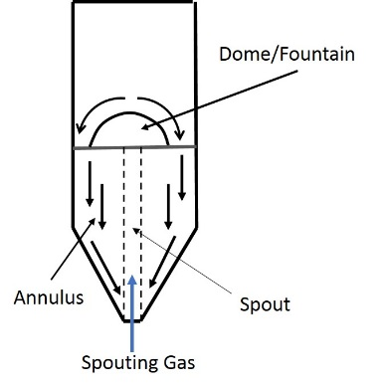
Background: Fundamentals of Spouted Beds
Used for fluidization of large particles (Geldart D)
Characterized by the formation of an axial dome .
Dome expands and pushes solids upwards until it reaches the bed surface.
Solids are thrown into the freeboard region and fall back to bed surface, forming the fountain structure.
Circulation regions formed within the annulus.
Typical spouted bed schematic
Photographic progression of spout formation in a 0.2m half-section spouted bed. (Curti, 2015)
Typical ΔP curve for identification of spouting velocity. (Curti, 2015)

Slide 6
Development Plan
Cold flow hydrodynamic analysis using Geldart D spoutable particles.
Cold flow analysis using Geldart D and C (cohesive) particles.
Hot unit design and testing.
Nylon Beads
Material Properties (Nylon Beads)
Physical Property | Value
Sauter Mean Diameter | 3.19mm
Particle Sphericity | 0.95
Particle Density | 1130 kg/m³
Void Fraction (packed bed) | 0.43
Minimum Fluidization Velocity | 1.565 m/s

Slide 7
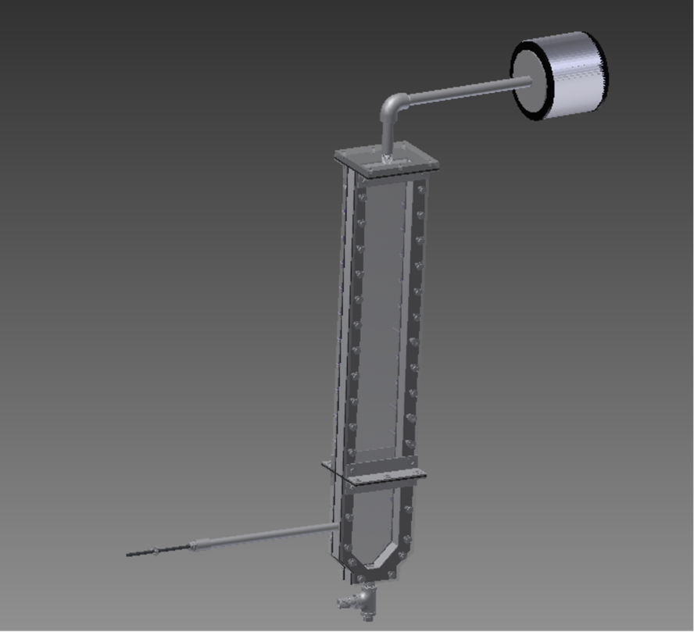
Experimental Setup
The current test unit is a rectangular spouted bed with a modular lower section that can be swapped out to study different cone angles.
Bed cross-section - 4” x 1 3/16”
Hydraulic diameter – 2.76”
Upper section height – 24”
Lower section height –varies
Cone angles (from horizontal)
45°, 60°, 75°
Nozzle diameters
½”, 3/8”
Side feed port for introduction of cohesive fines.
Hepa filtration of exhaust gas.

Slide 8
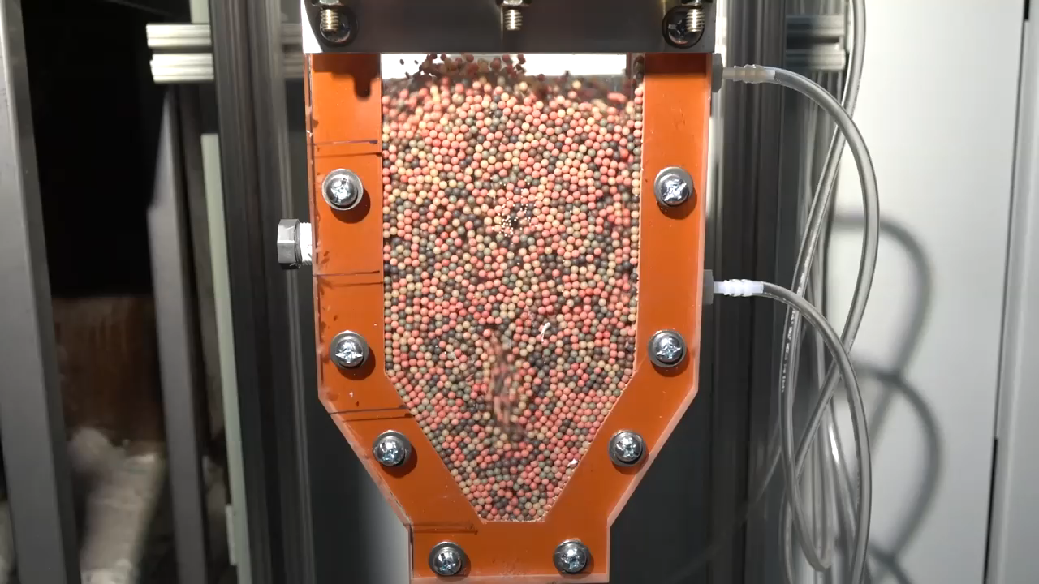
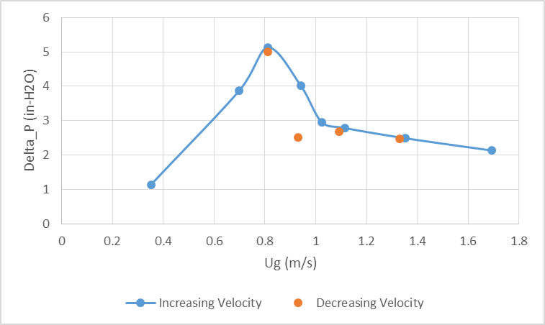
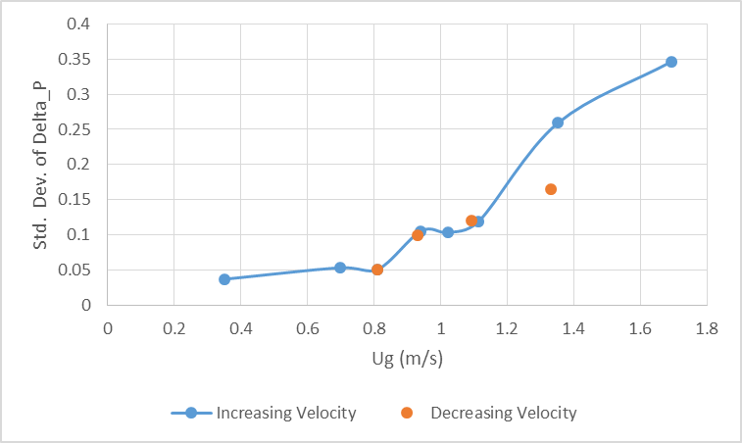
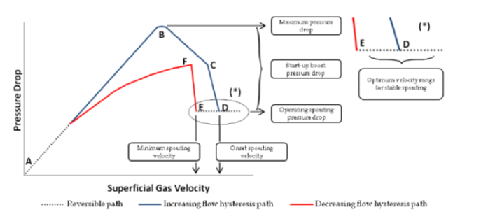
Preliminary Results: Ums Determination
Plot of bed pressure drop vs gas velocity (75°cone, 6” static bed height, 3/8” nozzle, 3.2mm nylon beads).
Standard Deviation of bed pressure drop vs gas velocity (75°cone, 6” static bed height, 3/8” nozzle, 3.2mm nylon beads).

Slide 9
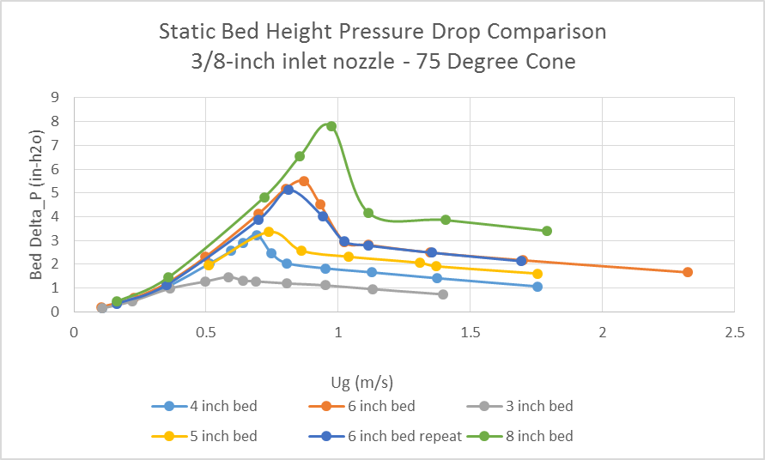
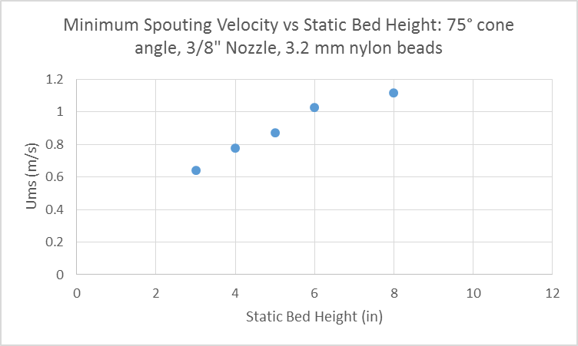
Preliminary Results: Effect of Bed Height
As Static Bed Height Increases:
Maximum Pressure Drop Increases
Velocity @ peak pressure increases
Minimum spouting velocity increases.
Plot of bed pressure drop vs gas velocity for various static bed heights. (75° cone angle, 3/8” nozzle, 3.2mm nylon beads)
Plot of Ums vs gas velocity for various static bed heights. (75° cone angle, 3/8” nozzle, 3.2mm nylon beads)

Slide 10
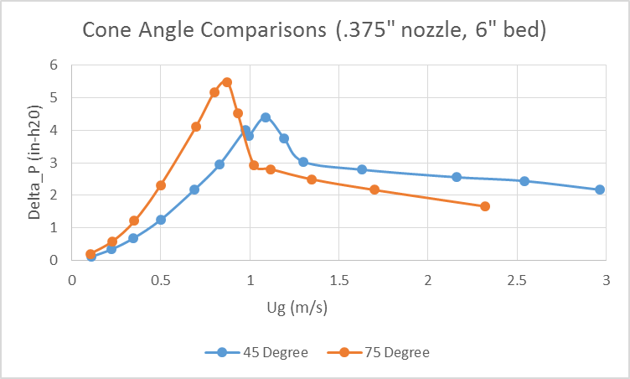
Preliminary Results: Effect of Cone Angle
As cone angle increases:
Ums decreases
Δp_{max} increases
Average Pressure drop vs gas velocity for different cone angles.

Slide 11

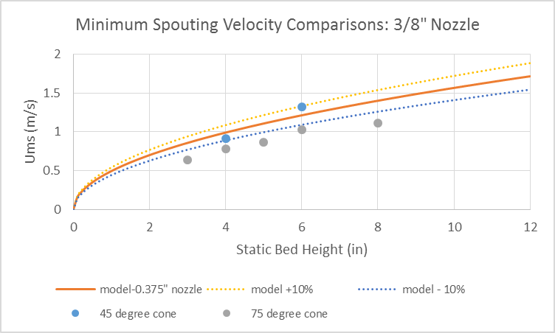
Preliminary Results: Model Comparisons
Mathur-Gishler Equation:
Prediction of Minimum Spouting Velocity
d_{p} – particle diameter
d_{j} – inlet diameter
D – bed diameter
H – bed height
+/- 10%
Mathur-Gishler Eqn. for estimation of miminum spouting velocity
Experimental data for larger cone angles falls outside of the listed error.
Suggests a need for a refined model that accounts for cone angle.
Comparison of experimental Ums values with Mathur-Gishler Eqn. values, with +/- 10% error ranges.

Slide 12
Ongoing Work and Future Plans
Ongoing Work:
Conduct additional experiments
(Bed Height, Cone Angle, Nozzle Diameter, Alternate Bed Materials)
System modification and testing
(slotted inlet configuration, additional bed widths)
Conduct experiments with Geldart D/C mixtures

Slide 13
Acknowledgements:
This research was supported in part by an appointment to the National Energy Technology Laboratory Research Participation Program, sponsored by the U.S. Department of Energy and administered by the Oak Ridge Institute for Science and Education.
Disclaimer:
This project was funded by the Department of Energy, National Energy Technology Laboratory, an agency of the United States Government, through a support contract with URS Energy & Construction, Inc. Neither the United States Government nor any agency thereof, nor any of their employees, nor URS Energy & Construction, Inc., nor any of their employees, makes any warranty, expressed or implied, or assumes any legal liability or responsibility for the accuracy, completeness, or usefulness of any information, apparatus, product, or process disclosed, or represents that its use would not infringe privately owned rights. Reference herein to any specific commercial product, process, or service by trade name, trademark, manufacturer, or otherwise, does not necessarily constitute or imply its endorsement, recommendation, or favoring by the United States Government or any agency thereof. The views and opinions of authors expressed herein do not necessarily state or reflect those of the United States Government or any agency thereof.

